Slide 1
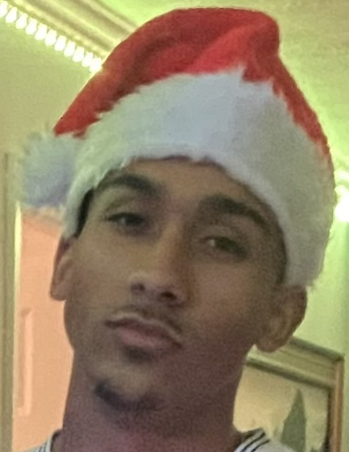
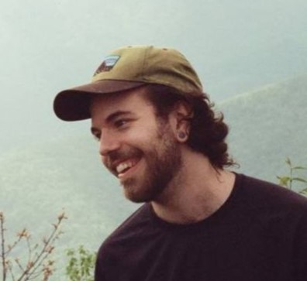
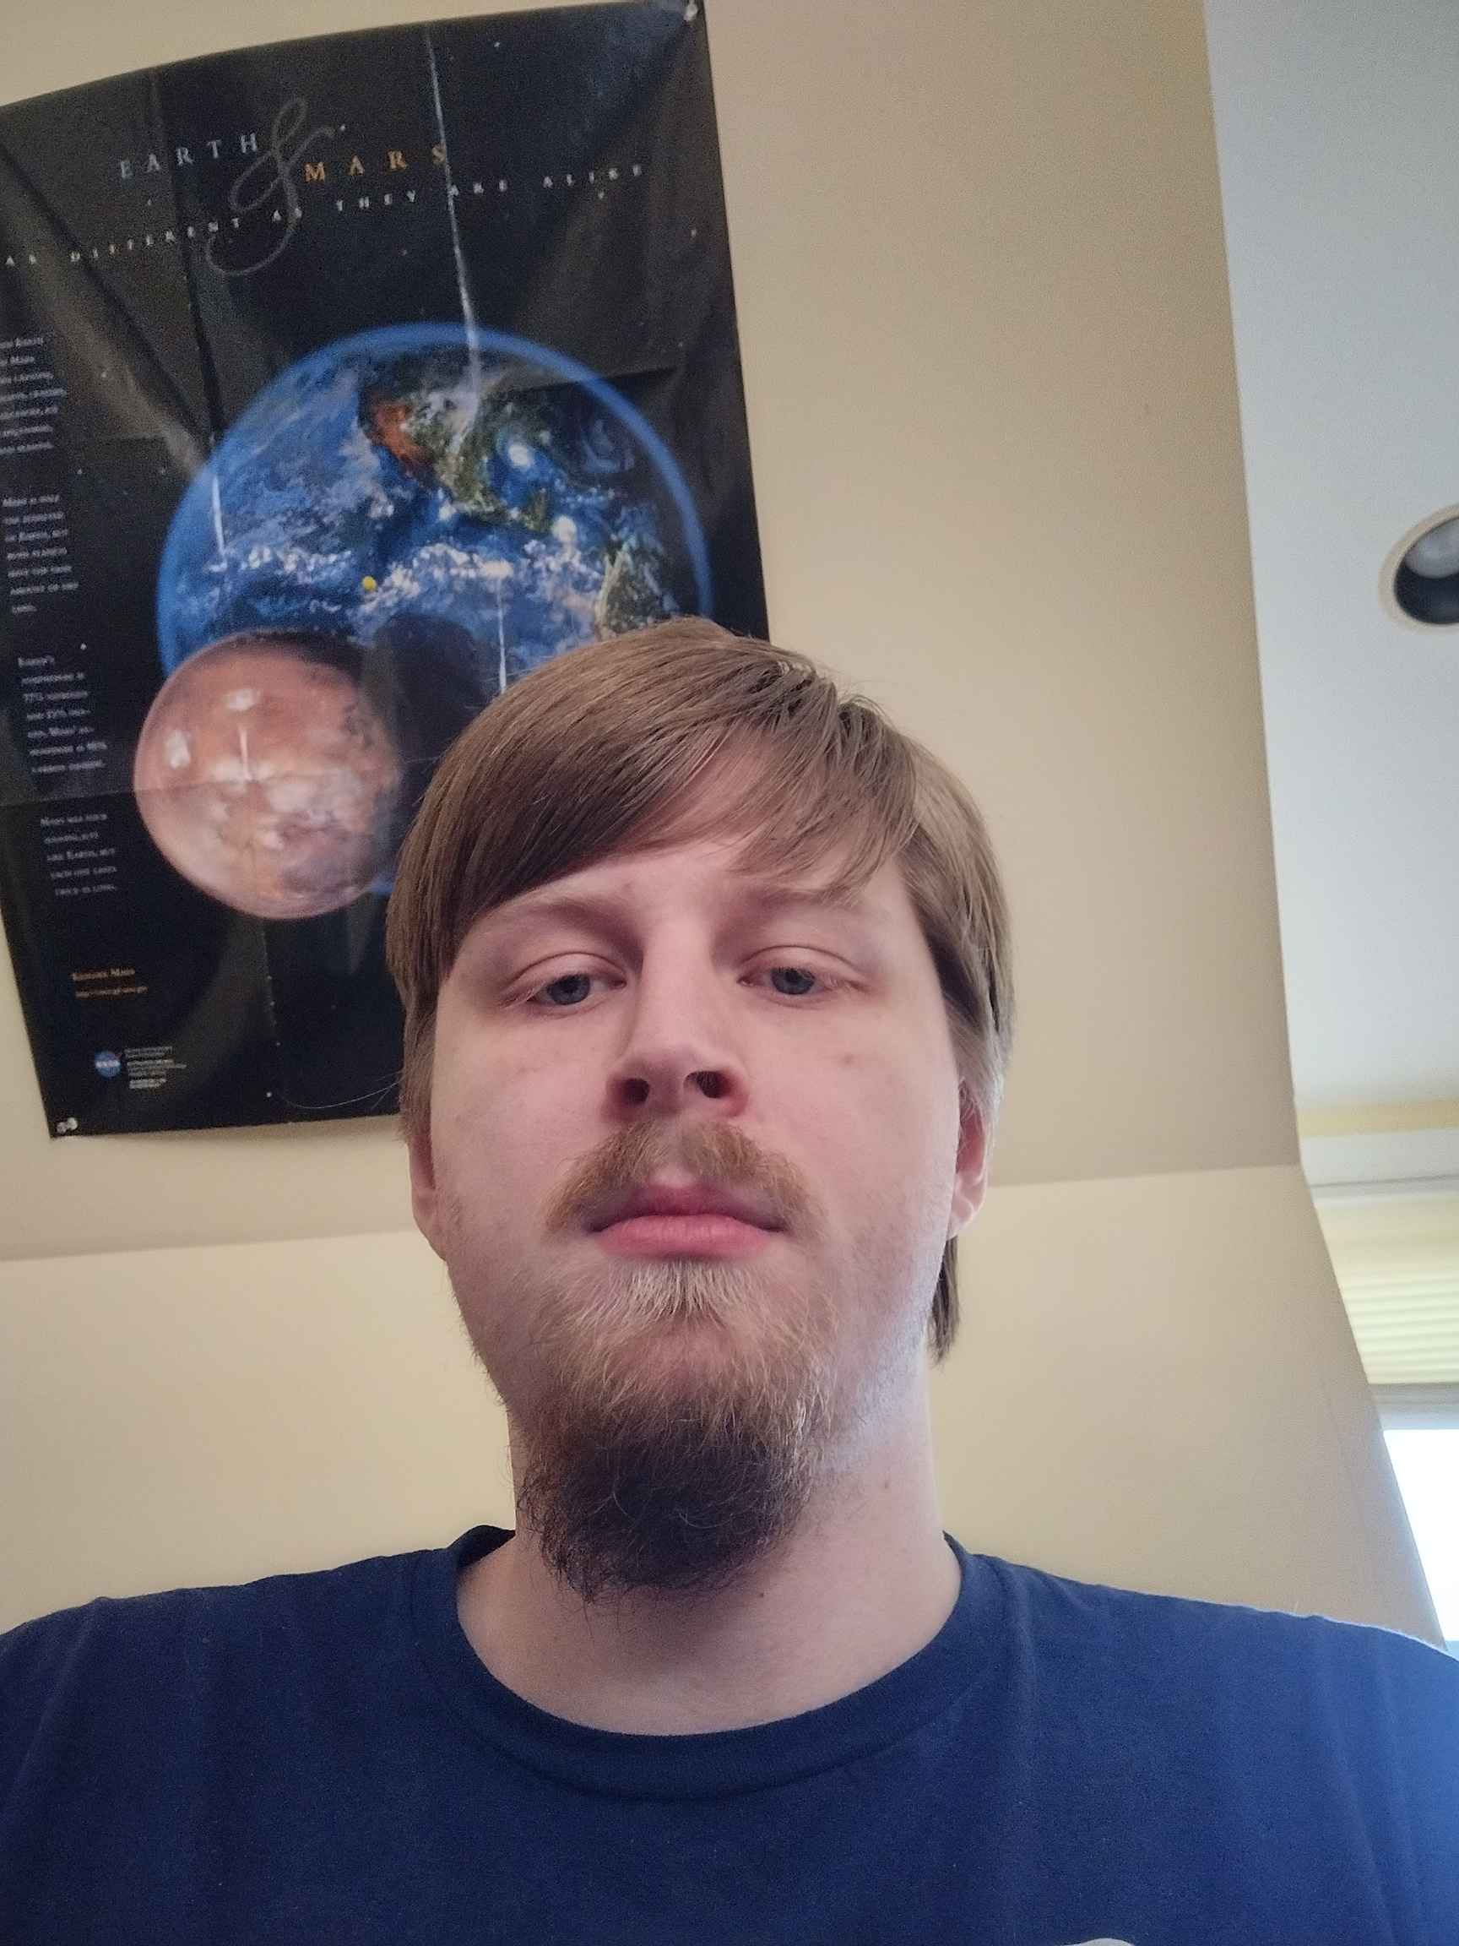
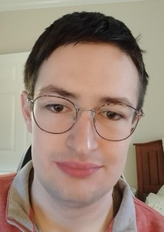
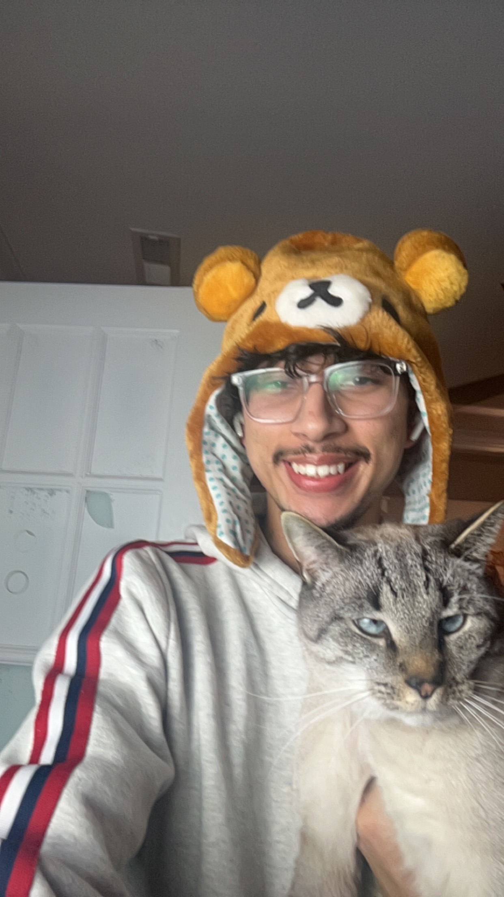

Trireme
Gustavo Santos
John Diveris
Michael Lowell
Patrick Brown
Frederick Hernandez
Yifan Gao
Project Manager
Lead Developer
Senior Developer
Testing
Documentation
UI/UX
Time Tracker/Manager App
Notes:
Greetings

Slide 2
Trireme Members
Gustavo Santos
John Diveris
Michael Lowell
Patrick Brown
Frederick Hernandez
Yifan Gao
Project Manager
Lead Developer
Senior Developer
Testing
Documentation
UI/UX
GitHub
Agile/Scrum
Microsoft Teams
Outlook
Notes:
Brief Introduction

Slide 3
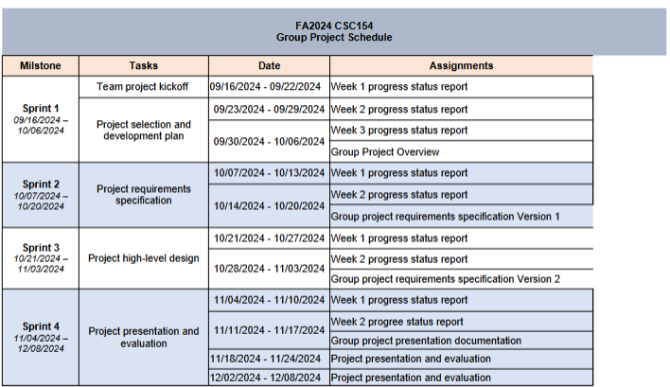
Team Collaboration & Project Management
Project Overview
GitHub
Agile/Scrum
Microsoft Teams
Outlook
The primary goal of the project is to develop an app that helps students become successful in their studies with the features offered through the app.
Notes:
We used GitHub as our central repository for version control, ensuring smooth collaboration. It allowed us to track changes, manage code reviews, and resolve conflicts effectively. Our team followed an Agile methodology with Scrum principles. We organized our work into sprints (4 to be specific), held regular meetings, and adapted to changing requirements, which kept us on track and productive. Microsoft Teams was our primary communication platform, enabling us to hold virtual meetings, share files, message team members, and keep everyone aligned on tasks and deadlines. We used Outlook for staying connected with our professor, Hong Cui (Sui), sending/receiving meeting invitations, reminders, (you know) any kind of activity that happened in Teams and/or GitHub was notified through Outlook. ”Next up we have Fred, he’ll be talking about the project more in-depth. Take it up Fred.”

Slide 4
Project Overview
The primary goal of the project is to develop an app that helps students become successful in their studies with the features offered through its services.
Notes:
To the right is a portion of the schedule used in order for us to stay on track with the project

Slide 5
Project Descriptions
Features/Functions
Assumptions/Dependencies
Task Timer: Allows users to start, pause, and stop a timer for specific tasks or study sessions.
Daily and Weekly Reports: Automatically generates detailed reports summarizing the time spent on tasks.
Goal Setting: Enables users to set daily or weekly time goals for tasks.
Technical Assumption: The software assumes it will be given correct data to create a study schedule for the user.
Operational Assumption: Users are assumed to have a basic understanding of task timing and familiarity with similar applications, reducing training needs.
Business Assumption: Users will have a stable internet connection for continuous application access.
Resource Constraint: Project has a fixed budget of $256,342 and a 6-month completion timeline.
Technological Constraint: Software must function and display correctly on both mobile and traditional computer devices.
External Constraint: Compliance with data protection laws is required, ensuring secure user data handling.
Operational Constraint: Software must support multiple user accounts with distinct schedules and tasks, including secure user authentication and data storage.
Performance Constraint: Software must support at least 680 concurrent users with a response time of under 2 seconds under normal conditions.
Notes:
We have some assumptions and dependencies for our users and app these being,
Users will offer correct data for a schedule, have a basic understanding of the software, and have to access a stable internet connection.
Dependencies being, having a fixed budget of 256,342, and a timeline of 6 months, software will work on mobile and computer devices while holding up to
680 users while maintaining a 2 sec response time. We will also abide by data protection laws and guarantee secure user access and data storage.
Pass it on to Yifan

Slide 6
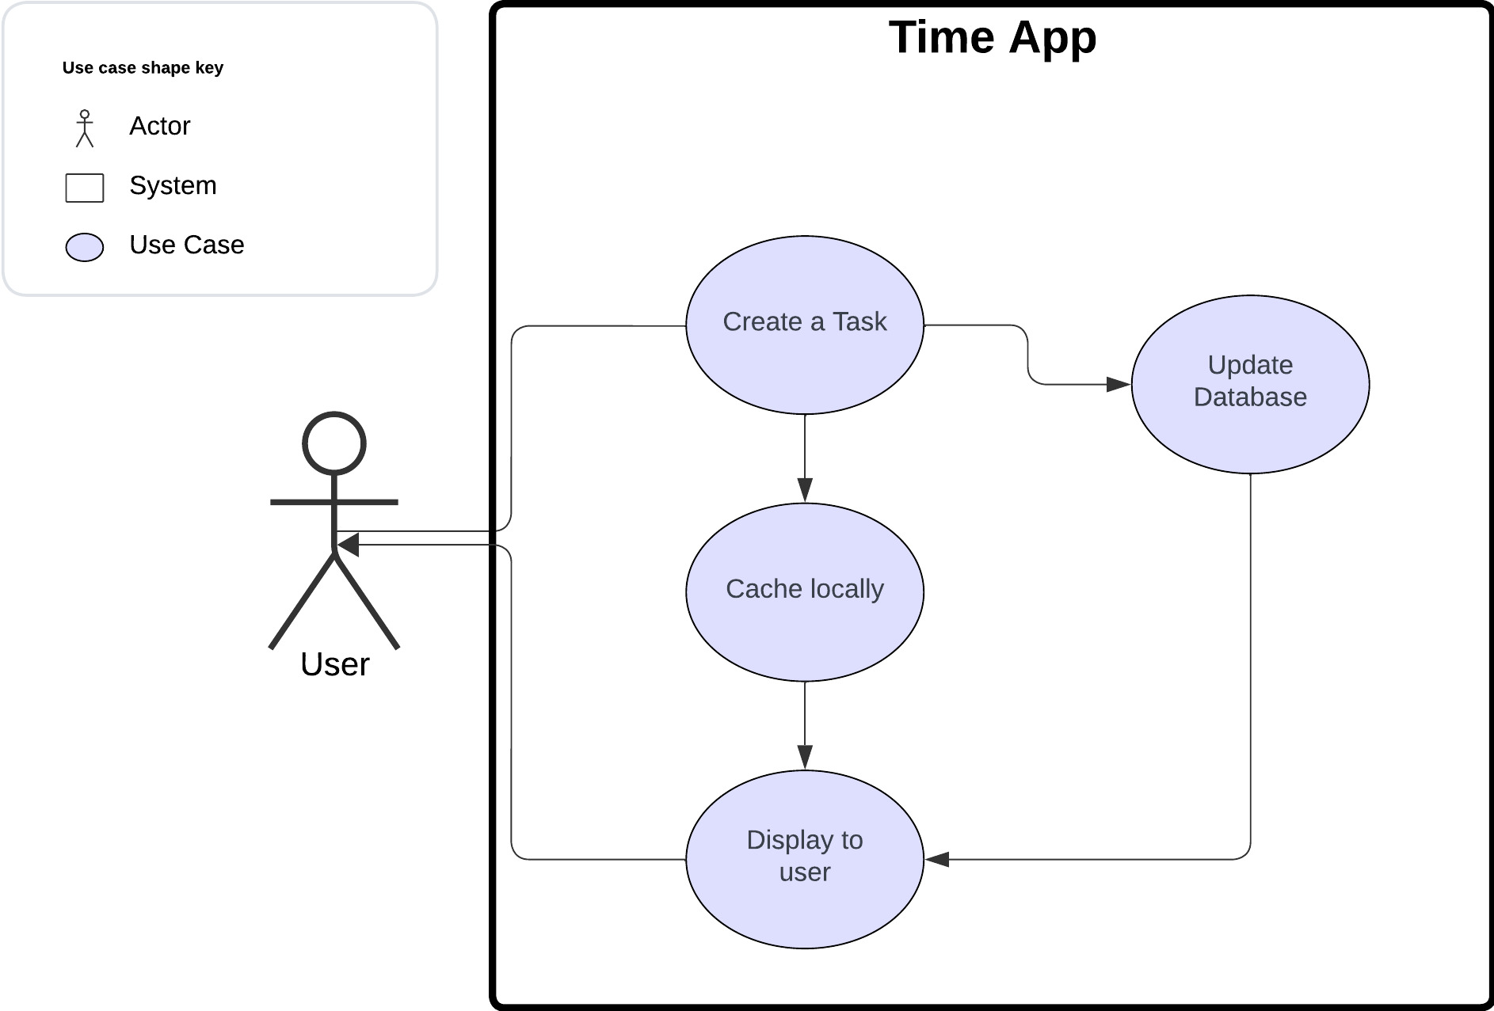
Use Case Diagram: User Creates a Task

Slide 7
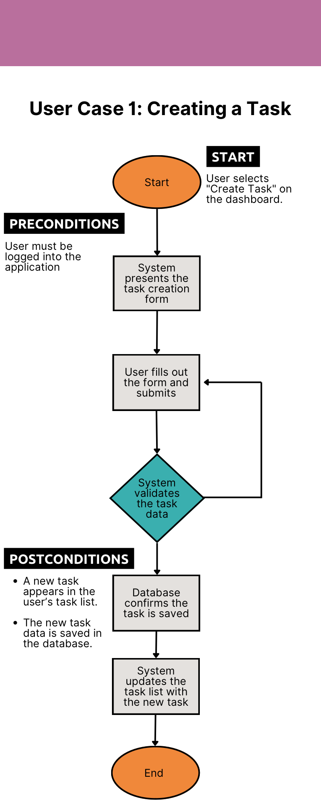
User Case 1:User Creates a Task
User Story 1: Creating a Task
As a user, I want to create a task with a name, description, due date, priority, and tags, so that I can organize and prioritize my work effectively.

Slide 8
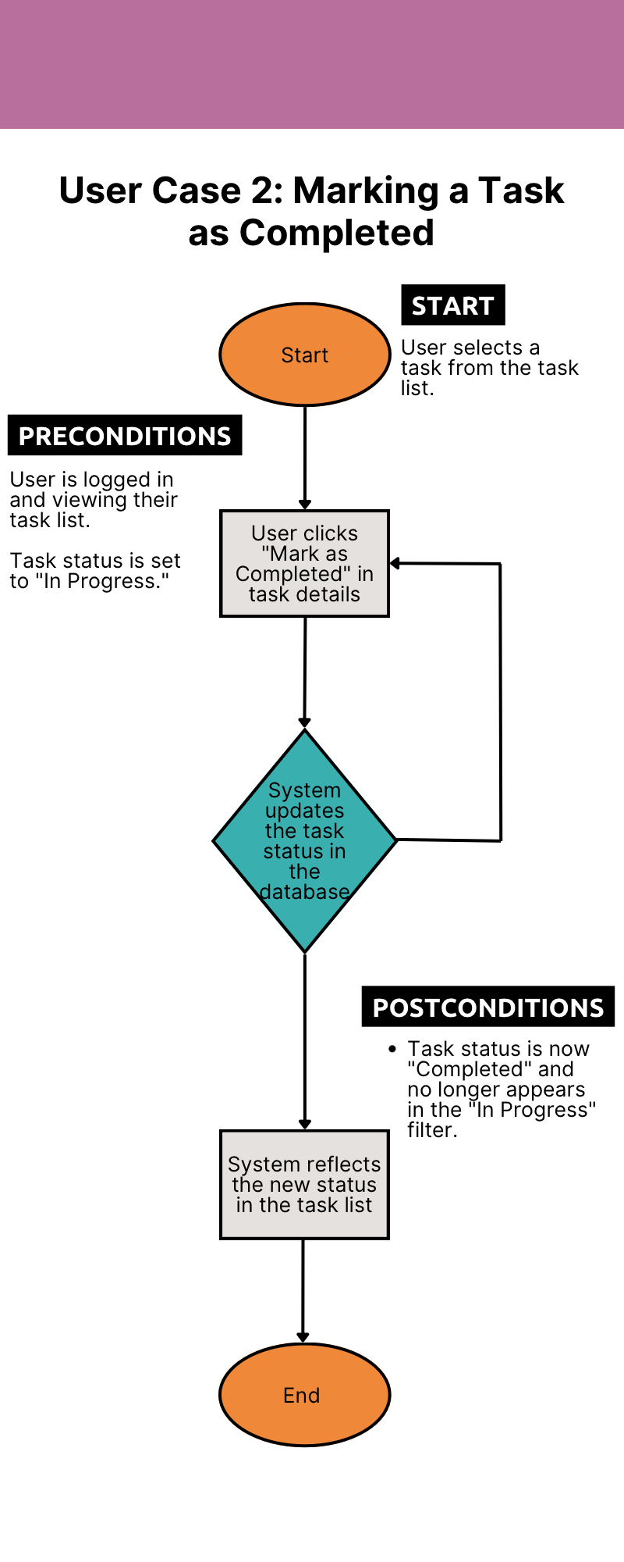
User Case 2: Marking a Task as Completed
User Story 2: User Sets a Task as Completed
As a user, I want to mark tasks as "Completed" once I finish them, so I can easily track which tasks are done and focus on pending tasks.

Slide 9
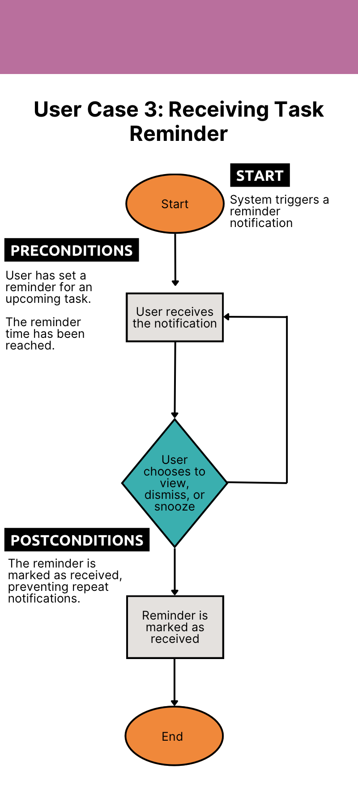
User Case 3: Receiving Task Reminder
User Story 3: User Edits an Existing Task
As a user, I want to edit details of existing tasks, such as adjusting due dates or updating task descriptions, so that my task list remains accurate and up to date.
Notes:
Pass it on to Patrick

Slide 10
Requirement Specs
User Requirements:
Allow users to create accounts and log in securely.
Provide a timer for tracking specific tasks or study sessions.
Show a task list with options to set reminders, define goals, and view progress.
Enable editing, deleting, and tagging tasks as "Completed" or "In Progress."
Generate productivity reports (daily/weekly).
Offer recurring task settings and customizable sorting by due date, priority, subject, or status.
Business Requirements:
Enable start, pause, and stop functions for a timer to track time on tasks.
Provide daily and weekly summary reports of time spent on tasks, with options for setting time-tracking goals.
Notes:
User Requirements:
Allow users to create accounts and log in securely.
Provide a timer for tracking specific tasks.
Enable editing, deleting, and tagging tasks as "Completed" or "In Progress."
Business Requirements:
Enable start, pause, and stop functions for task timers.
Provide summary reports of time spent on tasks, with options for setting time-tracking goals.
-PRESENTER NOTE: next slide please-

Slide 11
Requirement Specs
Functional Requirements:
Allow users to create tasks with essential attributes like name, description, optional date/time, subject tag, and priority.
Enable users to modify the details of existing tasks.
Provide the ability to delete tasks when no longer needed.
Default sorting by Due Date, Priority, and Creation Date, with support for custom sorting.
Ensure tasks and associated data are saved across sessions.
Offer in-app or email alerts and tailored notifications for time-tracked tasks.
Allow tasks to be optionally set as recurring and auto-populated based on time intervals.
Let users set and track personalized goals for specific subjects.
Restrict tasks to individual users, disallowing group collaboration or assigning tasks to others.
Notes:
Functional Requirements:
Allow users to create tasks with attributes like name, description, due date, subject tag, and priority.
Default sorting by Due Date and Priority, or custom sorting.
Allow tasks to be set as recurring and auto-populated.
Let users set and track personalized goals for specific subjects.
-PRESENTER NOTE: next slide please-

Slide 12
Requirement Specs
Non-Functional Requirements:
It should be used like any other program and inform the user every time they provide identifying data.
Implementation (Performance) Requirements:
Developed using Python and JavaScript for programing and Oracle as the database system.
Developed using the VS Code and GitHub version control.
Respond to input with a delay below 100ms and have a database that can process normal user's requests without slowdown.
It must load in under 1s on most mobile devices and the web portal must load as fast as YouTube on all web platforms and support modern browsers.
Notes:
Non-Functional Requirements:
inform the user every time they provide identifying data.
the web portal must load as fast as YouTube on all platforms and support modern browsers.
Implementation (Performance) Requirements:
Developed using Python and JavaScript for programing and Oracle as the database system.
Developed using the Visual Studio Code and GitHub version control.
-PRESENTER NOTE: Change slide during this next line -
I now pass you on to Michael.

Slide 13
High Level Design
Top Level Classes:
User
Task
Goal
Work Session
Tag
External interfaces:
Display
Timer
Push Notifications
Notes:
Now I'll cover the high level design plans we've established.
Our primary classes are:
User, which handles the vast majority of the data related to the user and the functionality they need to interact with the program
Task and Goal, which handle the tasks and goals the user sets.
Work Session, which handles the tracking and management of time during a work session
And Tag, which can be applied to most other objects for categorization, filtering, and other metadata purposes.
Externally, our application will primarily interface with
Displays and inputs, so that the user can actually interact with our program
System Time, so we know how long the user has been working and when to alert the user
and Push Notifications, so that we can send reminders to the user even if the app is not in active use
-PRESENTER NOTE: next slide please-

Slide 14

Security
Hardware and Architecture
Client – Server design
Rent servers
Rent databases
Secure UIDs
Secure Password Storage
2FA
Notes:
Since the information we're storing is relatively low-value, our digital security is mostly just the normal stuff.
The threats we are mostly worried about are brute force attacks.
To prevent them, We will make sure to implement UIDs, Passwords, and any future Tokens in secure ways.
We will also implement an optional 2FA system. This will allow a user to further protect themselves from digital data theft.
-PRESENTER NOTE: Change slide during this next line -
For physical security, we'll solve the issue by making it someone else's problem

Slide 15
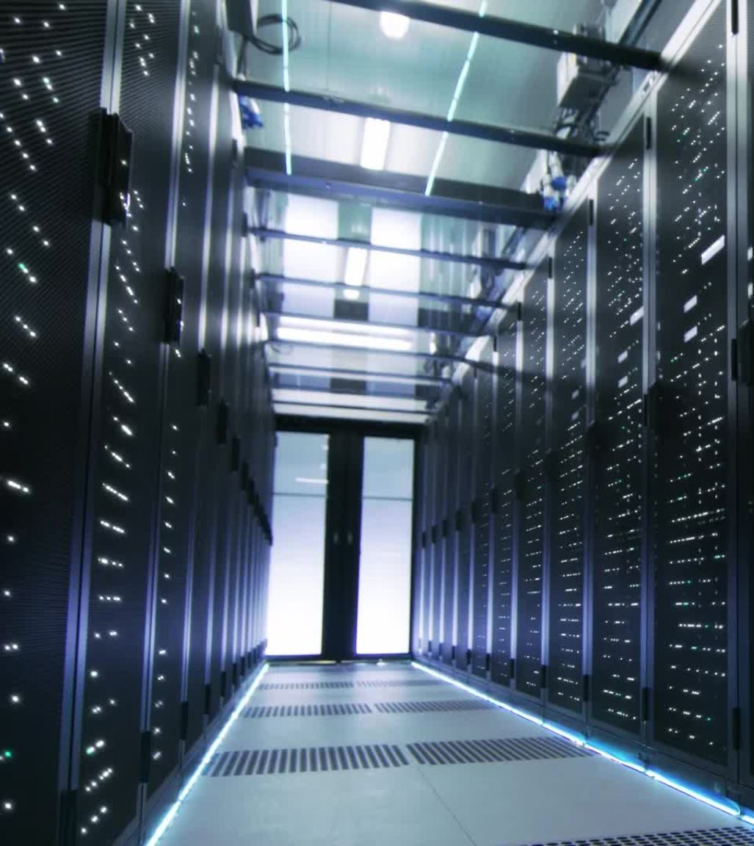
Hardware and Architecture
Client – Server design
Rent servers
Rent databases
Notes:
And by that, I mean we'll rent our servers from a webhosting service.
Our current thought is to contract AWS for our servers and database needs, though we have looked at other providers, namely MS Azure and Google.
Now, to discuss the finer details of our designs, John.
-PRESENTER NOTE: next slide please-

Slide 16
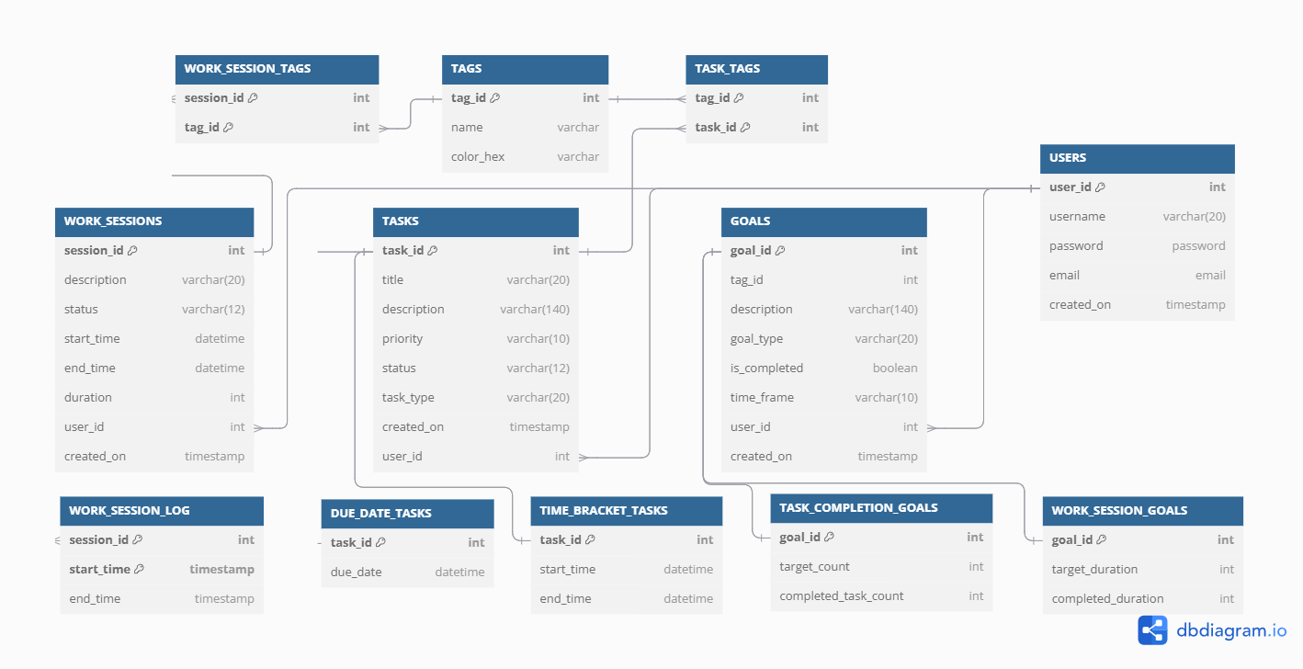
Database Design
Notes:
Taking a closer look we have tables For:
Task Data
Work Session Details + Log
Goal Details + Counts
Tag Details
User Data
Parent-Child Relationship between Task and Task Type.
Time-Bracket Tasks.
Due Date Tasks.
Junction Table for Many-to-Many relationship with tags.
What is a Work Session?
Table for logging each work session interval.
Junction Table for Many-to-Many relationship with tags.
Parent-Child Relationship between Goal and Goal Type.
Task-Completion Goals.
Work-Session Goals.
No generated columns.

Slide 17
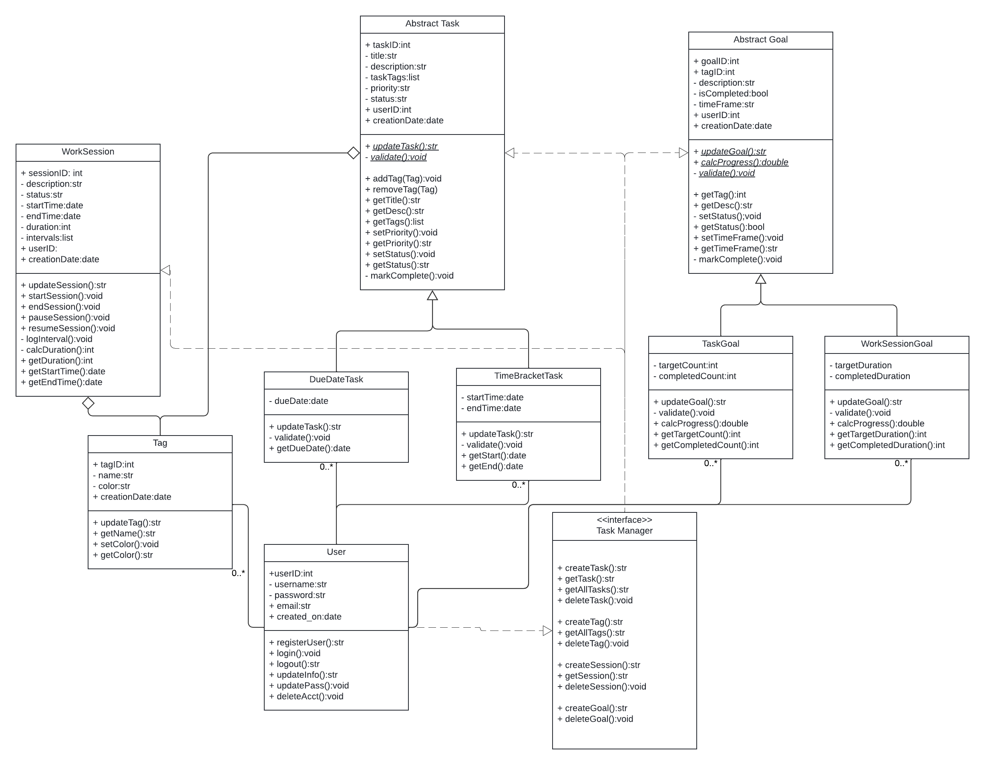
Class Design
Notes:
Using inheritance to mirror the Parent-Child database tables.
Tags are tracked via composition in instance attributes.
Interface Class for basic CRUD functionality.
Candidate for SQLAlchemy integration
TASK
Two Task classes inheriting from the abstract base class
Tags contained in a taskTags attribute (list)
Public Methods:
Getter/Setter methods
Update methods
Mark Complete
Private Methods:
Validator method
Abstract Methods:
+ updateTask():str
- validate():void
SESSIONS
Start Time/End Time attribute
Duration attribute
Intervals are held in a list attribute.
Public Methods:
Update method
Get methods
Start/Stop Methods
Private Methods:
Interval Logging
Calculate Duration
Validator method
GOALS
Two Goal classes inheriting from the abstract base class
Public Methods:
Getter/Setter methods
Update methods
Calculate Progress Methods
Private Methods:
Validator method
Mark Complete
Abstract Methods:
+ updateGoal():str
+ calcProgress():double
- validate():void

Slide 18
Achievements and Challenges
Achievements:
Modular Codebase Design
UML
GitHub
UI/UX Centered
Security & Database
Challenges:
Communication and Collaboration
Schedules
New Topics
Notes:
Our main Achievements while : Modular Codebase: Our team planned a modular codebase, making it easy to manage, test, and extend the application. This groundwork allows for independent development of modules, reducing potential integration issues in future implementation.
UML: (Unified Modeling Language) These diagrams were a first for most of us, if not all. We used them to visualize the system architecture and relationships between modules. GitHub: GitHub served as the backbone of our collaboration, enabling version control. This was also a first for a lot of us. UI Centered: We prioritized user experience by creating an intuitive and visually appealing interface.
Security & Database: We ensured that user data was protected through secure authentication protocols and an optimized database. These measures provide a reliable foundation for scalability and long-term application stability. Some of the Challenges we faced were: Com & Colab: Coordinating between team members with different schedules and communication styles was challenging. We addressed this by using asynchronous tools and holding regular meetings. Schedules: Balancing project milestones with individual commitments required careful time management. We adjusted by dividing tasks more efficiently and prioritizing critical deadlines. New Topics: Learning and implementing new concepts, such as secure database connections and advanced UI design, posed initial difficulties. However, we overcame these by researching extensively and supporting each other through peer reviews.

Slide 19

Future Development Plan
APIs Implementation
Task Sharing
User Performance Tracking
Website Implementation
Continuous Updates
Notes:
We plan to develop and integrate additional APIs to enhance functionality, such as enabling seamless third-party integrations, advanced analytics, and automation of routine tasks. Introducing task-sharing features will allow users to collaborate effectively. They will be able to assign tasks to others, share progress updates, and work on shared task lists in real-time. We aim to implement tracking features that analyze user productivity and provide insights. These could include personalized reports, goal achievement rates, and suggestions for improving task management. A dedicated website will extend the platform's accessibility, offering users an alternative to the mobile app and improving reach to a broader audience. We’re committed to maintaining the application with regular updates based on user feedback. This includes bug fixes, performance improvements, and the addition of requested features.
“And with that we’ll be wrapping up the presentation.”

Slide 20
Notes:
Give thanks
Questions
Comments
Concerns

